Slide 1
EmoSense: Real-Time Facial Emotion Detection and Analysis
PRESENTED BY:
NAME | ROLL NO
HONEY BANSAL | 2210990416
ISHAN SHARMA | 2210990420
ISHPREET SINGH | 2210990425
JAI CHOPRA | 2210990427
Under the supervision of
Mr. Shubham
Chitkara University Institute of Engineering and Technology
Chitkara University, Punjab

Slide 2
Overview
OVERVIEW
INTRODUCTION EMOTION RECOGNITION
CLASSIFICATION VISUALIZATION
METHODLOGY
CODE SNIPPETS
FACE DETECTOR DEMO

Slide 3
INTRODUCTION
• The Indian education landscape has been undergoing rapid changes for the past 10 years owing to the advancement of web-based learning services, specifically, eLearning platforms.
• In a physical classroom during a lecturing teacher can see the faces and assess the emotion of the class and tune their lecture accordingly, whether he is going fast or slow. He can identify students who need special attention. Digital classrooms are conducted via video telephony software program (exZoom) where it’s not possible for medium scale class (25-50) to see all students and access the mood. Because of this drawback, students are not focusing on content due to lack of surveillance.
• While digital platforms have limitations in terms of physical surveillance but it comes with the power of data and machines which can work for you. It provides data in the form of video, audio, and texts which can be analysed using deep learning algorithms. Deep learning backed system not only solves the surveillance issue, but it also removes the human bias from the system, and all information is no longer in the teacher’s brain rather translated in numbers that can be analysed and tracked.

Slide 4
PROBLEM STATEMENT
We will solve the before-mentioned
challenge by applying deep learning
algorithms to live video data.
The solution to this problem is by
recognizing facial emotions.

Slide 5
WHAT IS FACIAL EMOTION RECOGNITION?
• Facial emotion recognition is the process of detecting human emotions from facial expressions. The human brain recognizes emotions automatically, and software has now been developed that can recognize emotions as well. This technology is becoming more accurate all the time, and will eventually be able to read emotions as well as our brains do.
• AI can detect emotions by learning what each facial expression means and applying that knowledge to the new information presented to it. Emotional artificial intelligence, or emotion AI, is a technology that is capable of reading, imitating, interpreting, and responding to human facial expressions and emotions.

Slide 6
OTHER APPLICATION OF
EMOTION FACIAL RECOGINITION
Market Research: Companies have traditionally done market research by conducting surveys to find out about what consumers want and need. This method however, assumes that the preferences stated are correct and reflect future actions. But this is not always the case.
Another popular approach in market research is to employ behavioral methods where user’s reactions are observed, while interacting with a brand or a product. Although effective, such techniques can quickly become very labor intensive as the sample size increases. In such circumstances, facial expression recognition technology can save the day by allowing companies to conduct market research and measure moment-by-moment facial expressions of emotions automatically, making it easy aggregate the result.

Slide 7
CONT.
Video Game Testing: Facial expression recognition can also be used in the video game testing phase. In this phase, usually a focus group of users is asked to play a game for a given amount of time and their behavior and emotions are monitored. By using facial expression recognition, game developers can gain insights and draw conclusions about the emotions experienced during game play and incorporate that feedback in the making of the final product.
Facial expression analysis is a practical means of going beyond the typical survey approach. It is a way of appreciating what the user is experiencing, all while getting feedback. When feedback is taken in this format, it becomes genuinely non-intrusive when it comes to user experience.

Slide 8
OVERVIEW OF THE DATASET
The Face expression recognition dataset consists of 28,821 labeled images in the training set, 3,500 labeled images in the development set, and 3,500 images in the test set. Each image in dataset is labeled as one of seven emotions: happy, sad, angry, afraid, surprise, disgust, and neutral, with happy being the most prevalent emotion, providing a baseline for random guessing of 24.4%.
The images in dataset consist of both posed and unposed headshots, which are in grayscale and 48x48 pixels.
The dataset was created by gathering the results of a Google image search of each emotion and synonyms of the emotions

Slide 9
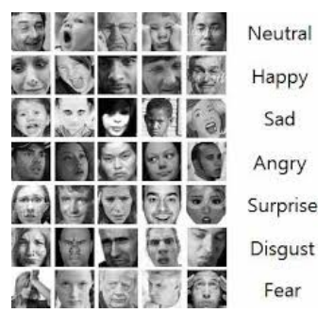
PROBLEMS IN DATASET
PROBLEMS IN DATASET
Imbalance Dataset
Intraclass Variation
Contrast
Eye-Glasses
Outlier/Null Values

Slide 10

DEPENDENCIES
DEPENDENCIES
Opencv

Slide 11
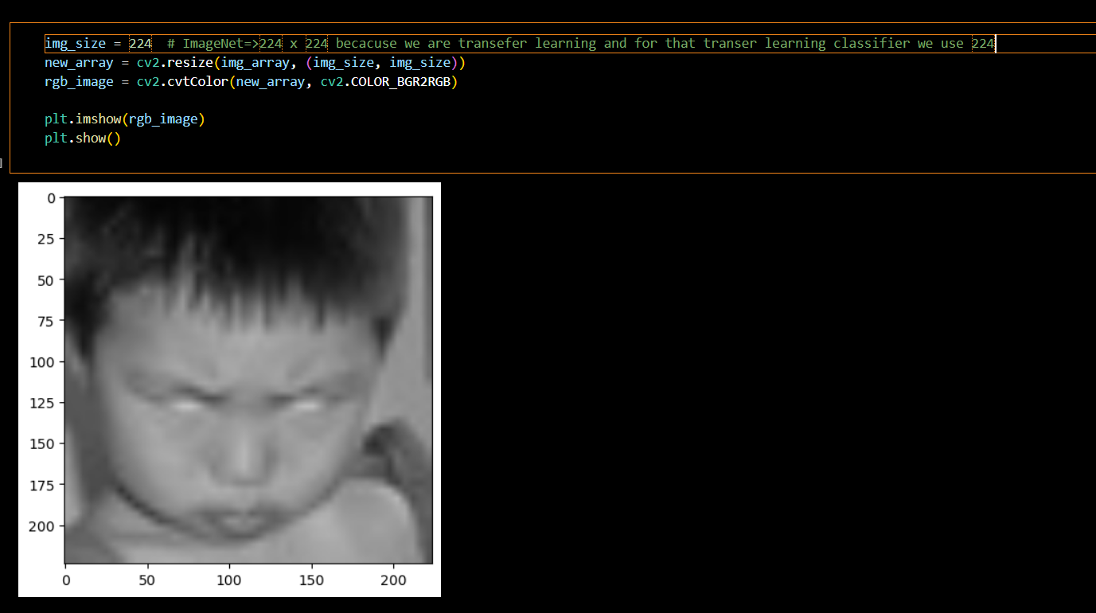
RESULT

Slide 12
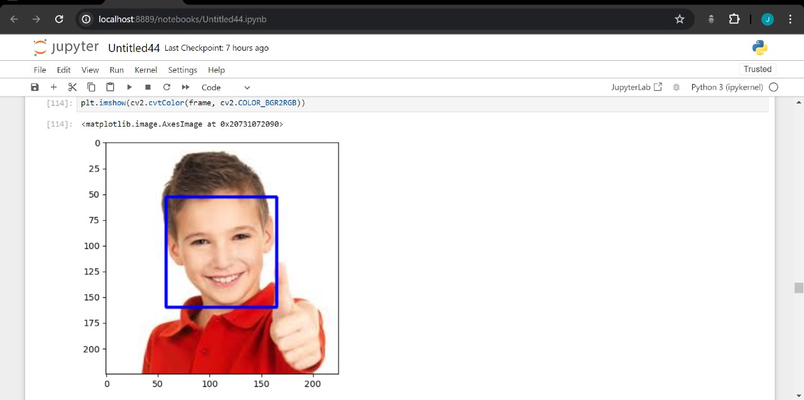
RESULT

Slide 13
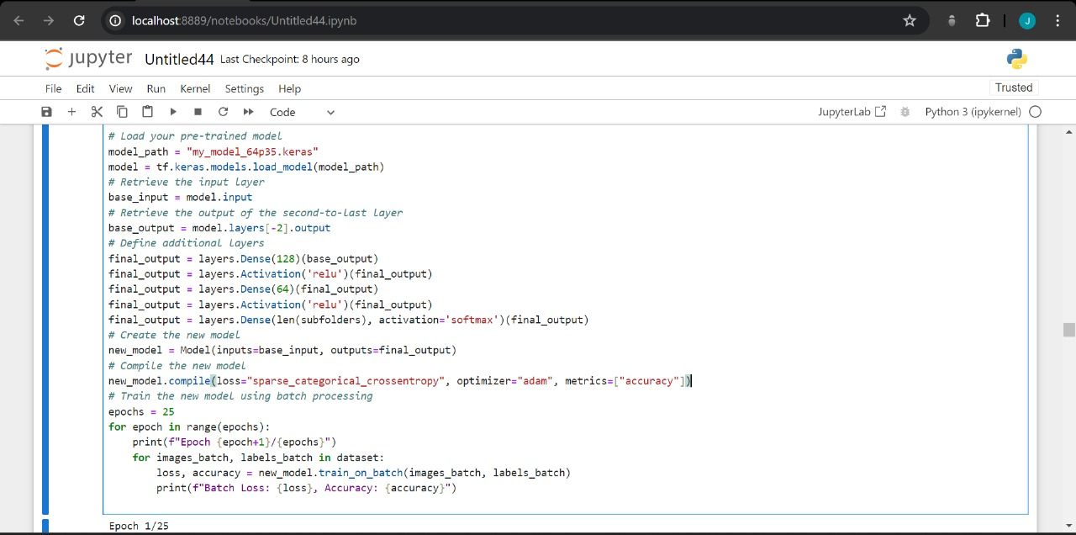
MODEL TRAINING

Slide 14


Slide 15
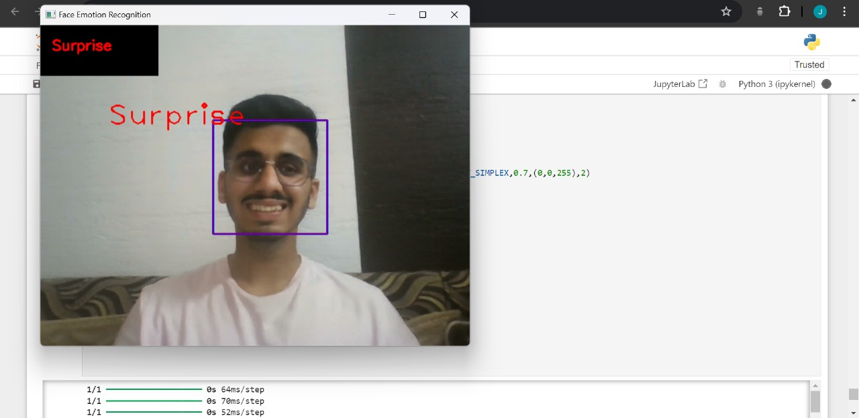
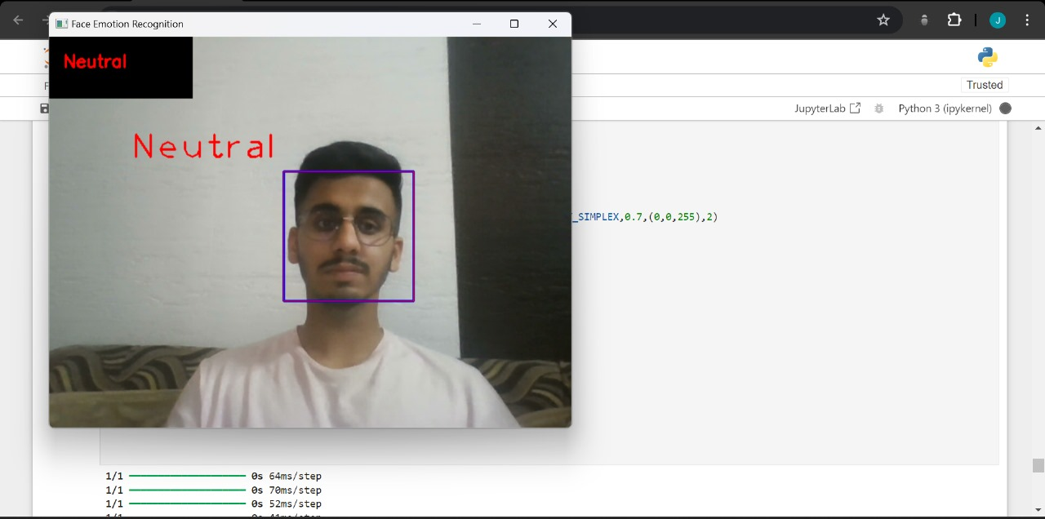
WORKING OF MODEL

Slide 16
CONCLUSION
CONCLUSION
Can get input from different camera’s
Changed code to be more efficient
We have visualizations
Use face detection

Slide 17
FUTURE WORK
FUTURE WORK
Handle partial occlusions better.
Make it more robust (lighting conditions etc.)
More person independent (fit mask automatically).
Use other classifiers (dynamics).
Apply emotion recognition in applications. For example games.

Slide 18
References
Data set :
https://www.kaggle.com/datasets/jonathanoheix/face-expression-recognition-dataset/code

Slide 19
Questions???
Any Questions
Feel Free to Ask…

Slide 20
Thanks...

